Slide 1

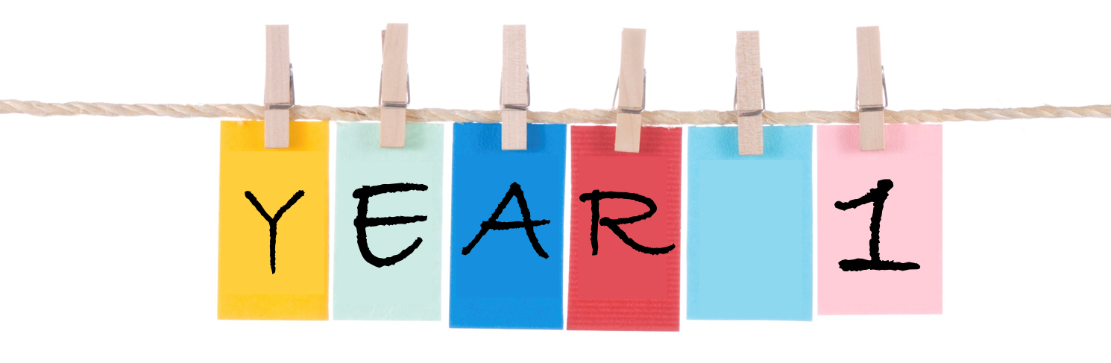
St John Fisher’s and
St Margarets’s

Slide 2
St Margaret’s –
Teacher: Mrs Conyard
TA: Mrs Clarke
St John Fisher’s –
Teacher: Miss Cowperthwaite
TA: Mrs Cowell

Slide 3

School lunches- children are entitled to a free school dinner but must be booked on bromcom- if child is bringing a lunch from home this must also be booked.
Reading record- children have a reading record yellow book-could you record that you have heard your child read? Five minutes a day makes a huge difference not only to their reading skills but also for their writing.
Read a poem, a newspaper, a comic, a recipe, even a picture.- ask questions what can you see/? What sounds would you hear? What do you think is behind the tree?
Developing reading skills is paramount for their progression. Don’t forget to come to our reading mornings, if you cannot attend send a family member.
We have been assessing the children as we have adopted a new phonic scheme so the children will be bringing home books to help them learn to read but also a picture bok to share with you.

Slide 4


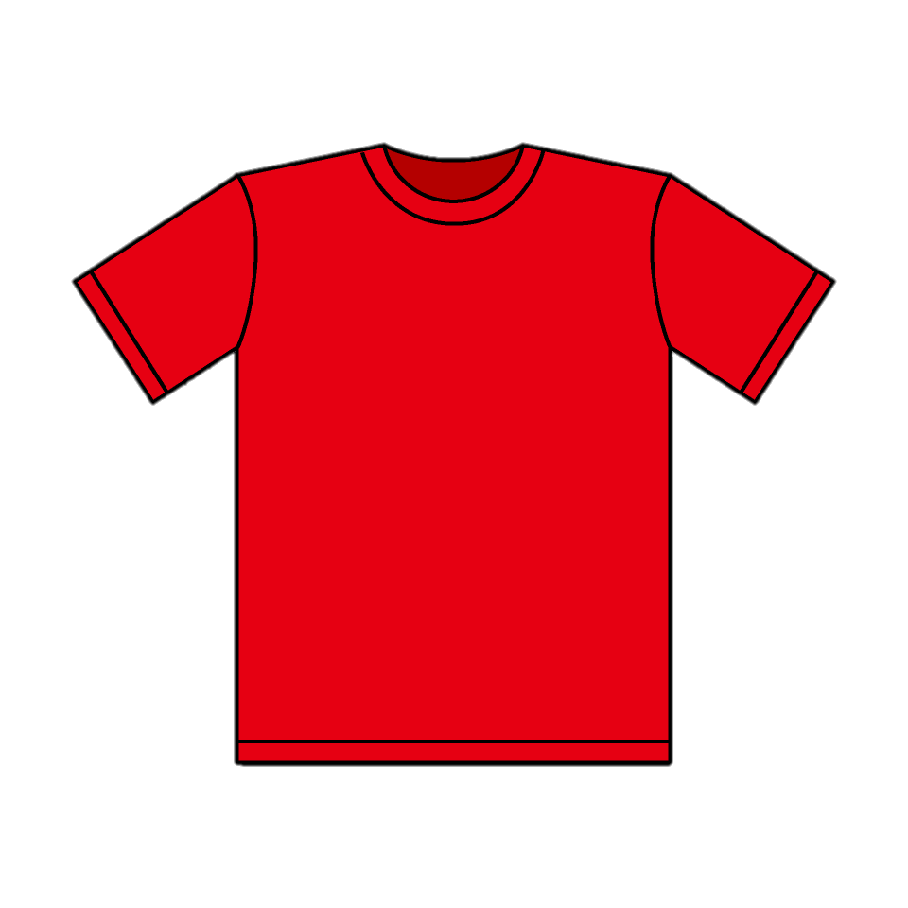
Important information
PE is on a Friday.
Children come into school with their PE Kit on.
Children can wear a plain coloured t-shirt reflecting the house they are in or the school yellow t-shirt.
Children also need a water bottle, please name it!
Trainers not plimsoles please and no earrings.
If your child wears earrings make sure they can take them out by themselves.

Slide 5

There is fruit available for all children but your child can bring in a snack from home. Just one as some children are bringing too many.
If they bring a snack box please ensure it is labelled just like their jumper!!!
Remember our school is a healthy school so no chocolate bars please.Please remember we are a nut-free school. We do have children with severe allergies

Slide 6
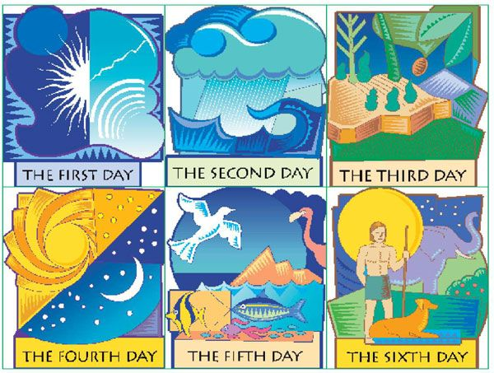
In Re we are learning about The Creation Story.
We are encouraging the children to think about our wonderful world linking with our science knowledge on senses- What can we see? What can we hear? What does...feel like?

Slide 7
Big Maths – CLIC
C-Counting, L-Learn-its,I-It’s nothing new, C-Calculations.
This half term the children are working on CLIC 2/3 moving onto 4 which includes learning their number bonds to 10, doubles and counting forwards and backwards to 20.

Slide 8
Phonics we are currently revisiting the learned sounds from Reception, please practise their sounds with them. We are working on putting some sounds together and blending them into words.
C a t=cat sh i p =ship
Science
We are learning to recognise and name different parts of our bodies and will be using our senses for writing.

Slide 9
Our topic
All about what makes me special?
Pictures /photos will be put on the class learning zone on the website please send an email to the school office to allow pictures to be taken and uploaded as this is key to their learning.
The children will be given a homework book. This is for children to complete with their family at home.

Slide 10
Website- www.st-helens.southend.sch.uk
The schools website is full of information and copies of the newsletter can be found on there although everyone is sent by email on a Friday if you would like a hard copy let us know. Important dates for class trips assemblies and performances are on there as well as pictures of what the children get up to during the week.
Year 1 learning zone – st-helens westcliff website – (then to curriculum- then to classes- then to year 1-) this will be updated with pictures of activities and also has the topic web and homework web .

Slide 11
Any Questions or concerns please talk to us or you can send an email to the school office or email us direct on
year1@st-helens.southend.sch.uk

