Slide 1

Welcome to Year 2!
Parent Meeting

Slide 2
St. Ursula-
Mrs Kearney (Mon, Tues, Wed), Mrs Driscoll (Wed, Thurs, Fri)
& Miss Colwell
St. Augustine–
Miss Paice & Mrs Cooper

Slide 3

Snack
Snacks should be healthy
E.g.
fruit
raisins
vegetables
plain biscuits
breadsticks
No chocolate bars, cakes, sweets or crisps.
Fruit and vegetables from the school are offered to the children during break time.
Remember we are a nut-free school!

Slide 4
Children do not need to bring in their own stationary. Everything in provided by school.
Children should not be sharing toys, keyrings, bracelets etc. in school. Please keep it at home.

Slide 5

Reading may look a little different this year, as we have recently introduced a new reading scheme.
You may have noticed that we have not yet sent home colour-banded books. This is because we are currently assessing all of the children and rolling out the new scheme. Thank you for your patience while we complete this process.
Your child will bring home two books:
A decodable/fluency book (until they become an independent reader), which should be easily accessible for your child to read independently.
A picture book, which is intended for shared reading and enjoyment with an adult.
Please note that you do not have to use a school book for shared reading. You are welcome to choose and enjoy any book with your child at home.

Slide 6
Why Reading Matters
Reading with your child every day is one of the most powerful ways to support their learning.
Just 10 minutes of reading a day can make a huge difference.
Children who enjoy reading are more likely to achieve well across the curriculum.
Reading Record Book
Reading Builds More Than Reading Skills
Develops vocabulary and language skills.
Improves listening and concentration.
Strengthens memory and understanding.
Encourages curiosity and imagination.
Reading Together Matters
Reading together creates special moments and positive associations with books.
Talking about stories helps children understand what they are reading.
Sharing books boosts confidence and a love of reading.
How You Can Help at Home
Read with your child every day.
Listen to them read their decodable book.
Enjoy and discuss picture/ chapter books together.
Ask questions about the story and pictures.
Celebrate effort and progress.

Slide 7

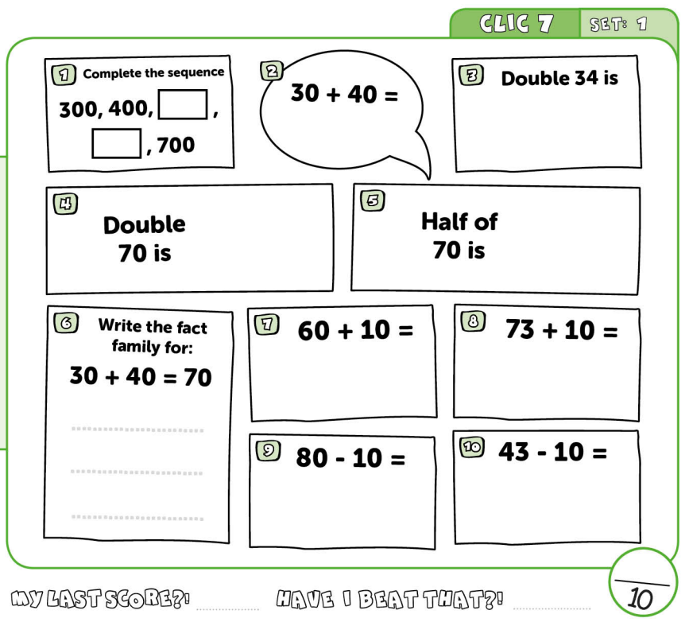
Big Maths
- We do a weekly CLIC test in class. The children love it! It covers lots of the strategies we have learnt in class that week. The children try to beat their previous score.
-The CLIC test has ten questions and follows the same format each week.
-The children need to get 10/10 three weeks in a row before they can move up to the next CLIC.
- Learn its are also completed each week. This is a timed activity to test their quick recall of facts learnt.

Slide 8
Topics
Our topic this half term is Wild World. This science-focused topic will explore a range of animals and their habitats, helping the children to develop their understanding of the natural world. We will also make links to our English learning by creating animal fact files and writing instructions. There will be plenty of opportunities for creativity throughout the topic, too.
Our next topic will be The Great Fire of London, where we will explore this significant event in British history and learn about its impact on London today.
Other topics: Superheroes, Castles, Twisted Tales, Pirates

Slide 9
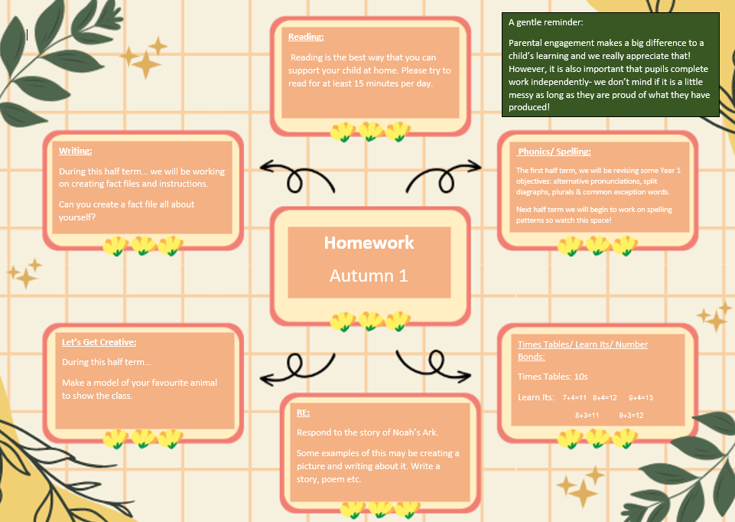
Homework
This will be
emailed to you.

Slide 10
P.E.
- PE is on a Friday.
Children to come in wearing their P.E kit instead of school uniform.
No earrings and no tights.
Children can wear either a yellow t-shirt, or a t-shirt in the colour of their house.
Trainers rather than plimsolls please.
Please name everything that belongs to your child!!!!!!!!!

Slide 11
Any questions?

Slide 12

Thank you for coming!

