Slide 1


Year 4 - St Swithun (Mrs Hall) &
St Bede (Miss McGill)

Slide 2
Some of our topics:
Autumn 1 – Rivers / States of matter / Quest story writing
Autumn 2 – Sound / Iron Man / Instruction writing
Spring 1 - European regions / Escape from Pompeii / Newspapers
Spring 2 - The Romans / Persuasive writing / Electricity
Summer 1 - The Butterfly Lion / Living things & their habitats / Local history
Summer 2 - The digestive system / Descriptive writing

Slide 3
Things to remember in Year 4:
PE carousel days are on a Thursday until February. Make sure your child comes in wearing their PE kit on a Thursday without jewellery or earrings.
Please can your child bring a pair of trainers to keep in school so they can change out of their school shoes into them for daily mile.
Please keep using the online ordering system for lunches (even if your child is packed lunch, this needs to be selected).
Snack: healthy food only please - not chocolate, crisps or anything with nuts.

Slide 4
Things to remember in Year 4:
Please ensure your child has a labelled water bottle everyday.
Please label your children’s clothing e.g. jumpers and coats.
Children have agreed class rules and responsibilities and are expected to adhere to this to support the learning of themselves and others.
Remind your children of the safety features when using computers and videogames. Please keep a regular eye on what they are using/watching.

Slide 5
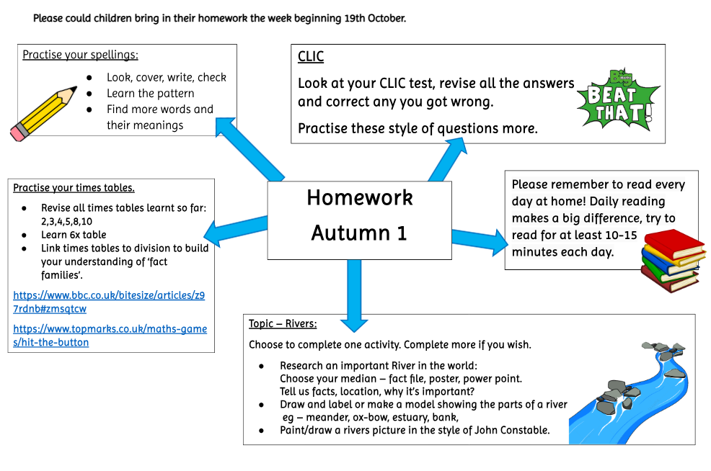

Slide 6
Dates for your diary:
Monday 30th November | St Andrew’s day assembly
Tuesday 15th December | Year 3 & 4 Carol service
Thursday 8th October | St Swithun class assembly
Thursday 14th January | St Bede class assembly
Wednesday 24th March | Easter performance

Slide 7
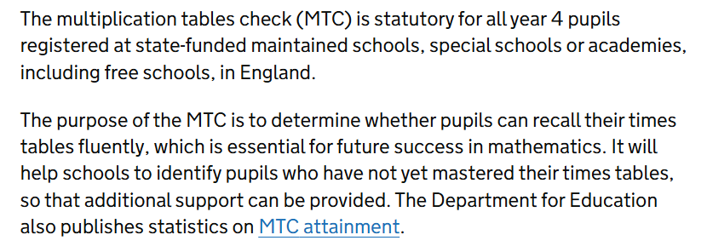
Multiplication tables check will take place in June

Slide 8
Make sure you check your emails/facebook/website for pictures, updates and important messages.
Please let us know if you have any problems.
You can directly contact us by e-mailing: year4@st-helens.southend.sch.uk
Thank you for your attendance.

