Slide 1
Hello and welcome to Year 6.
St Osyth: Mrs Norman and Mrs Green.
St Anne Line: (Mrs Richards, Mrs Green and Mrs Allen

Slide 2
This half-term, our topic is Living Things and their Habitats.
Here are the curriculum areas we will be covering…
Maths: Place value, 2 and 3-dimensional shapes, angles, area/perimeter, revising times tables.
Reading: Our whole-class reader is Beetle Boy. Also, formal comprehensions.
Writing: Description, editing, newspaper report, persuasive leaflet, balanced argument.
Grammar, spelling and punctuation: Word classes, types of sentences, spelling patterns.
RE: Creation and Covenant – original sin, baptism/forgiveness, Jesus as restorer.
Geography: Mountains – focusing on Scafell Pike.
Art: Pencil and ink sketches of beetles - Looking at the artist Natalie McIntyre
Science: Living Things and their Habitats. Tying together the curriculum – beach visit tomorrow to look at coastal habitats (check emails/texts to ensure your child is suitably equipped), study of beetles and their habitats (linked to our reading and writing), mountainous habitats.
PE: On Fridays, children attend school in PE kit and in the afternoon, attend three different 35-minute lessons (netball, football and fencing). Daily Mile on other days.
Music: Djembe drums of west Africa.
Modern foreign language: Spanish

Slide 3
Job descriptions for pupil leadership have already been distributed.
There are many roles available: headship team, house and sports captains and class mentors to name a few.
Aim to have applications in by Monday 12th October. Hustings will be held on Monday the 19th and election on Wednesday 21 October. Do encourage and help your child to apply.
It is a great opportunity for them to take on a position of responsibility in their final year of primary school.

Slide 4
Do attend Year 6’s joint Skreens assembly,
which they will be performing on
Thursday 1st October.

Slide 5
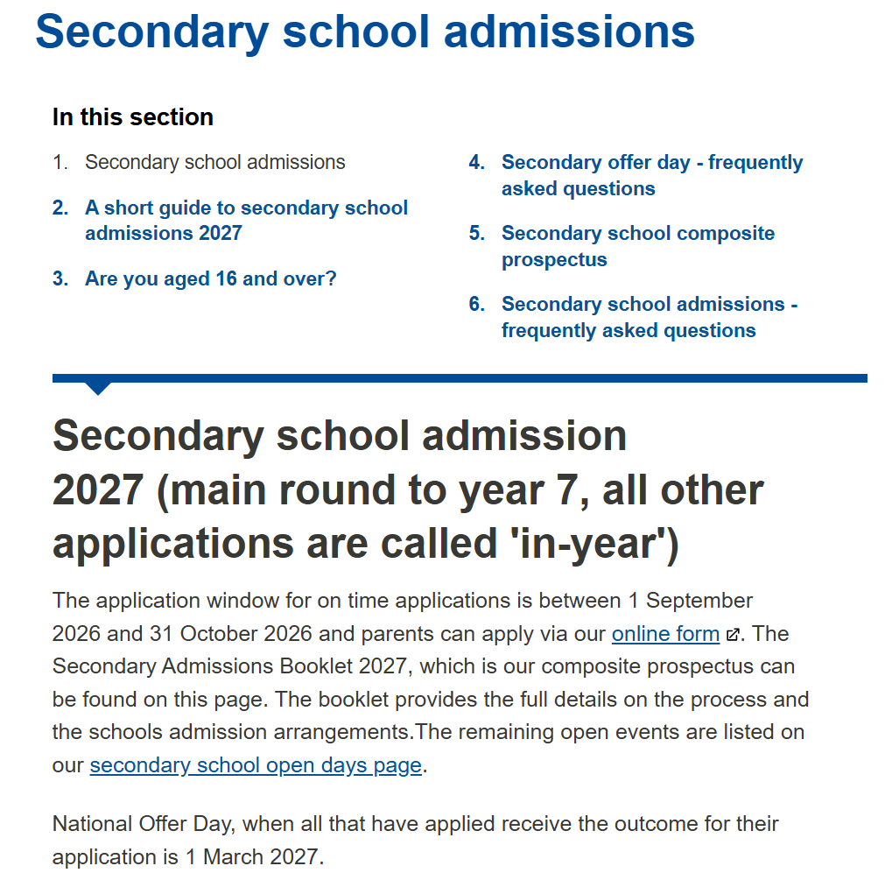
Note the deadline for applying for secondary schools.
Visit the Southend Council website for details.
If applying outside Southend area, see
relevant website.
Monday 5 October
Support for secondary applications – parents’ meeting at 3.30pm in the studio

Slide 6
Reminders…
Classrooms are open from 8.30am.
Pack healthy snacks, lunches and a water bottle. Please remember that we are a nut free school.
Correct uniform must be worn including ties and jumpers/cardigans (please ensure all uniform is clearly labelled with a name).
Children need a pair of trainers in school each day to run the mile in.
On Fridays, children should not come to school wearing earrings.
Other events coming up soon…
Borough Cross Country is this Friday 26th September and the Borough Tag Rugby tournament for Years 5 and 6 on Wednesday 1st October. Please check your emails/texts to ensure you are aware if your child has been selected.
2nd Oct - no school and 22nd Oct - children finish at 1.15, no after school club.
15th Oct - School photos for individuals and families.
10th, 17th, 24th Oct - parents invited for the Rosary at 3pm (half-term 24th)
13th/20th November - Flu vaccine (don’t forget to consent if you wish to).

Slide 7
Homework
Each Wednesday, maths and grammar homework is set and is expected to be completed or marked the following Wednesday.
Each Friday, comprehension homework is sent home to be marked the following Friday.
Children must revise the week’s spelling pattern/rule and are tested on Friday. They will not be given a list of words to be tested on. They may be tested on an unfamiliar word so it’s important they learn the pattern/rule.
Other homework (including online tasks) will be issued as and when needed.
Children should read from a book they enjoy with an adult for at least 15-20 minutes each day, discussing the text and any unfamiliar words.
Children must know their times tables up to 12 x 12 at speed. They can practise writing a table out whilst timing themselves, and try to beat their time. When they can do this at speed, they can play an online game called Hit the Button, which helps develop their fluency.

Slide 8
Parents’ evenings will be held in November to discuss your child’s progress and attainment levels.
Book your slot.
The date of your meeting will depend on your child’s house. Please check your events calendar.
12.10 St. Patrick
13.10 St. George
14.10 St. David
15.10 St. Andrew
There will also be another opportunity to meet in the spring (February/March).

Slide 9
To understand the coverage for maths and English, please refer to the National Curriculum.
Overview…
Throughout the rest of the year, we will also be exploring topics such as:
the Ancient Mayans
the geography of North America
the theory of evolution
how the human heart works.
We will be reading from Beetle Boy and a selection of poetry.
Our writing genres will include narratives, instructions, diaries, non-chronological reports and persuasion texts.
Our upcoming RE topics include: Prophecy and Promise, From Gallilee to Jerusalem and From Desert to Garden. We will be celebrating the World Day of Prayer.
We will also be sewing and investigating where the food on our plate comes from. After their SATs exams, the children will be preparing for and rehearsing for their end of year extravaganza on 14th July.

Slide 10
SATs 2027 – Statutory Assessment Tests
Dates: Monday 10th May – Thursday 13th May
Usually following this format:
Monday - Grammar and punctuation (45 minutes); a spelling test (about 15 minutes).
Tuesday – Reading comprehension test (3 texts and questions in one hour).
Wednesday – Arithmetic (30 minutes); first reasoning paper (40 minutes).
Thursday – Second reasoning paper (40 minutes).
Writing assessments
There is no writing SAT; however, the children’s writing ability will be assessed throughout the year according to a framework to determine whether or not they meet the expected standard for Year 6.

Slide 11
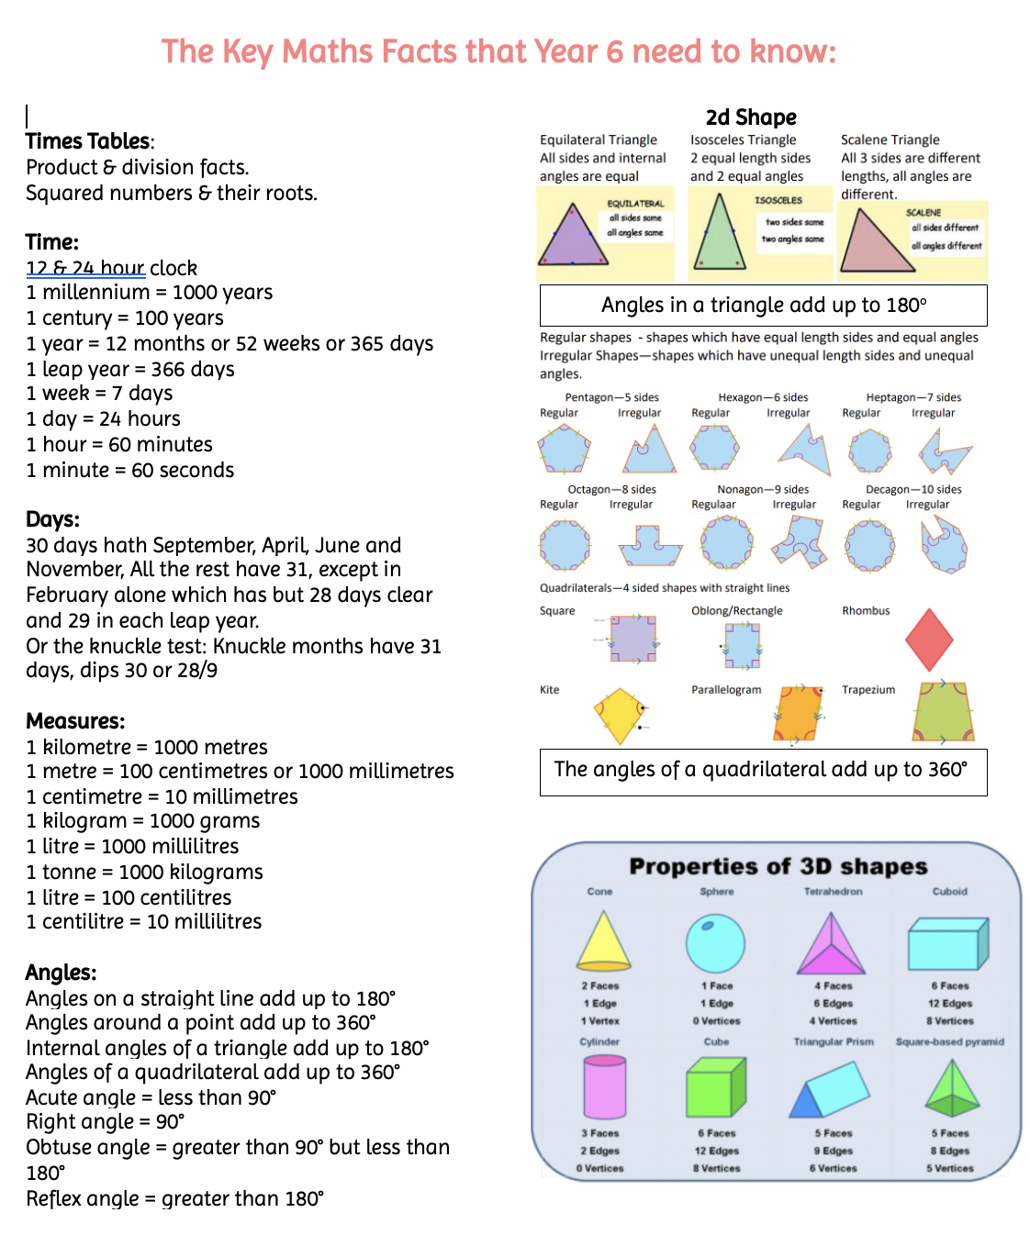
Sats Papers

Slide 12
Year 6 residential
Where: Skreens Park near Chelmsford.
When: Wednesday 23rd September - Friday 25th September.
Just over a week away! All information has been sent out through email. Please can you ensure that all medical forms are back as these are a basis around our risk assessments.

Slide 13
ST HELEN’S CATHOLIC PRIMARY SCHOOL
SKREENS FACT SHEET 2026
MEDICINES - Please provide any medication that your child may need during their time away in a polythene bag or envelope to be clearly labelled with the child’s name and the dosage. This must be listed on the Medical form – this list should include antihistamine and paracetamol as well as prescribed medication. All medication and the form must be given to the member of staff in charge of medication on the morning of the trip by parents/carers NOT THE CHILD please. If you need a form please collect from the office.
PLEASE NOTE SCHOOL STAFF HAVE A SUPPLY OF ANTIHISTAMINE, PARACETAMOL AND CALPOL FOR ANY CHILD THAT NEEDS IT.
COACH TIMES – Wednesday 23rd September - Depart St Helens at 9.00 am. approx. - Children will need to be in school by 8.30 am. and return on Friday 25th September at 2.00 pm approx. Please collect your child at 2.00 pm from the school hall. We will update you by text on this day.
CLOTHES - Plenty of layers. NOT BEST CLOTHES. T-shirts, jumpers, shorts, tracksuit bottoms/sports trousers, leggings, socks, non-slip trainers x 2, (not new), indoor shoes/slippers. Waterproof clothing (if you have any) and coat depending on the weather. Swimming costume.
BEDDING - pillow sleeping bag or duvet and *** FITTED BOTTOM SHEET essential
TOILET REQUISITES - to include 2 towels (1 for shower, 1 for swimming).
SUN PROTECTION - Sun block and hats are essential. Woolly hat if it is cold.
PLASTIC DRINKING BOTTLE – named, refillable - to be used over the three days *** essential
2 LARGE BIN BAGS – to take home any damp clothing.
SAFETY - All instructors at the Skreens Park Activity Centre are well-qualified.
ACTIVITIES
Bridge building, camp fire, bushcraft, cave bus, archery, emoji trail, climbing, rafting, kayaking, wheelchair course, sensory trail
FOOD - Cereal, cooked breakfast, toast.
Cooked lunch meal.
Cooked evening meal.
Lunch Friday - Sandwiches at midday - picnic outside.
Cameras – only disposable cameras are allowed.
NO mobile phones are allowed.
NO smart watches or fitbits are allowed.
NO handheld computer games are allowed.
NO food or sweets.
Children may take appropriate reading materials or inexpensive games - e.g. Top Trumps, for use during relaxation time.

Slide 14
Please keep checking your St Helen’s booklet for important dates throughout the year, and also your emails and texts for any new developments or events.

Slide 15
Thank you.
Any questions?

